Slide 1

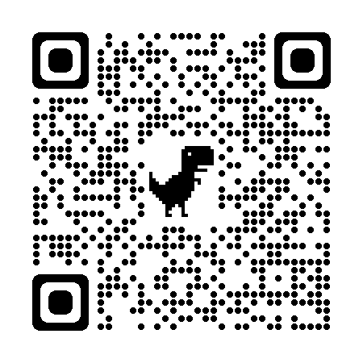
Practice Placement
Allocations Office
(PPAO)
2025 Orientation
If you need to contact us

Slide 2

Practice Placement Allocations Office (PPAO)
Who we are?
Bernie Maher, Louise Greene & Eimear Doherty
What we do?
We ensure that all students can gain experience in all the specific practice placement areas prescribed by the Nursing and Midwifery Board of Ireland (NMBI) for registration purposes
Where can you find us?
C001
Behind Pulse cafe

Slide 3
BSc Nursing & Midwifery Programmes
BSc Programmes in the school have 2 main elements:
Theory 50%
Practice placements 50%
At the end of your programme, you hope to achieve two outcomes, which combined will allow you to work as a nurse or midwife in Ireland:
BSc (Nursing) or BSc (Midwifery)
Professional Registration with the NMBI

Slide 4
Practice Placements
The type and duration of the practice placements you will attend is prescribed by the NMBI
General, Mental Health and Midwifery students there is a required minimum of 81 weeks
Children’s & General students there is a required minimum of 95 weeks
Practice placements are classified as either
General/Core Placements: generally in stage 1 and 4
Specialist placements: generally in stage 2 and 3
Internship
Occurs in Stage 4 of your programme
36 weeks in total

Slide 5
Practice Placements
In Stage 1 you will attend practice placements
5 weeks starting 12/01/2026 (provisional dates)
6 weeks starting 23/03/2026 (provisional dates)
Practice placements will occur in a variety of Health Care Providers (HSP) across a large geographical area, not just the Dublin region
your allocated parent hospital(s)
all sites within the Dublin and South East Health Region
all sites within the following HSE regions:
  Dublin and North East
  Dublin and Midlands

Slide 6
Where can your Stage 1 placements occur?
Parent HSP | Stage 1 Placement Sites
General - SVHG | SVUH, SMH, St. Columcilles, Blackrock Clinic, Beacon Hospital or St. Vincent’s Private Hospital
General - MMUH | MMUH, Mater Private, Santry Sports Clinic, Cappagh or Clontarf Hospitals
Mental Health - SJGUH | SJGUH or Cluain Mhuire Community Services around Stillorgan and Dun Laoghaire
Mental Health - CHE | Community Services as well as in-patient services between Clonskeagh, Elm Mount Unit in SVUH Campus or Newcastle Hospital and Community Services
Children’s & General - CHI SVUH | CHI Crumlin, Temple Street, Tallaght and Connolly (child) and SVUH (adult)
Children’s & General - CHI MMUH | CHI Crumlin, Temple Street, Tallaght and Connolly (child) MMUH (adult)
Midwifery - NMH | National Maternity Hospital, Wexford Maternity Unit, Kilkenny Maternity Unit, Mullingar Maternity Unit

Slide 7
Practice Placements
In order to meet the minimum NMBI registration requirements, 100% attendance at practice placement is required
During registration you must complete the Programme Requirements, stating that you understand and accept:
full attendance on all practice placements is mandatory
attendance is monitored and all absences are recorded
any time missed due to absences must be made up in full before progressing to the subsequent stage of the programme
any time missed due to absences is scheduled to be made up at any time in the summer holiday period and the timing is at the discretion of the associated health healthcare providers
This means that students must be available to attend practice placements from mid May to early July 2026 if you have absences to make up - do not book flights/holidays for Summer 2026 until you are sure that you do not have time outstanding

Slide 8
UCD Student Code of Conduct
You are expected to act in a responsible way and take responsibility for your conduct
Take responsibility for your behaviour, on and off campus, and ensure that your actions don’t have a negative impact on yourself, others or the University.
Uphold the same high standards of good conduct while undertaking internships or work experience placements.

Slide 9
School of Nursing, Midwifery & Health Systems – Fitness to Practice
Fitness to Practice means having the skills, knowledge, health and character necessary to undertake and complete a programme with professional practice, experiential learning or clinical work safely and effectively, fulfilling the responsibilities within the scope of practice in a chosen field.
The primacy of the patient experience; making patient care and that of their significant others the primary concern, treating them as individuals and respecting their autonomy and dignity.
Work with others in a spirit of mutual respect, collegiality and partnership to protect and promote the health and wellbeing of those being cared for, their families, carers, and the wider community.
Provide a high standard of practice and care at all times.
Be open and honest, act with integrity and uphold the reputation of the professions.

Slide 10
Vaccination and Screening Programme
A free service offered by your parent hospital’s occupational health department
Strongly recommended to ensure your safety and that of staff/patients you will encounter
Appointments will be scheduled from October onwards
Please send your vaccine history information to your occupational health department ASAP as per Orientation Pack

Slide 11
Vaccination and Screening Programme
Infectious Disease or Agent | Screening | Vaccination | Programme(s)
Hepatitis B | If proof of immunity is missing or level of immunity is insufficient | If clinically indicated by Occupational Health | All
Measles, Mumps and Rubella (MMR) | If proof of immunity is missing or level of immunity is insufficient | If clinically indicated by Occupational Health | All
Tuberculosis (TB) | If proof of immunity is missing or level of immunity is insufficient | If clinically indicated by Occupational Health | All
Chickenpox (Varicella) | If proof of immunity is missing or level of immunity is insufficient | If clinically indicated by Occupational Health | All
Influenza | - | Highly recommended | All
Covid-19 | - | Highly recommended but required by some Health Service Providers (HSPs) | All
MRSA | Required for specific practice placements | If clinically indicated by Occupational Health | All
Pertussis (Whooping Cough) | If proof of immunity is missing or level of immunity is insufficient | If clinically indicated by Occupational Health | Midwifery Children's & General Nursing

Slide 12
Vaccination and Screening Programme
COVID-19 and Influenza vaccinations also highly recommended
Not offered through occupational health but available through HSE
Students not fully vaccinated while on practice placement must minimize contact with patients, to the greatest degree possible, in high-risk areas
Some HSP’s will require proof of COVID-19 vaccination
Bring your COVID-19 vaccination certificate to all your practice placements

Slide 13
ARC – Practice Placement Record
ARC is the online system used to administer and permanently record your practice placement details
Login details will be sent to you in early December once all mandatory requirements have been completed
you will be given a demonstration during your Academic Advisory in mid November
ARC will provide to you:
Details of your practice placement: location, duration, contact information
In stage 2/3 it will detail your MRSA screening appointments

Slide 14
PPAO Communication
Over the coming months we will be emailing you with regard to the mandatory requirements you must complete in advance of attending any practice placements
If you receive an email from us you MUST engage with it, you will receive only one reminder email
The onus is on the student to ensure they are compliant with all mandatory requirements
The onus is on the student to regularly check your UCD Connect Email account
No practice placements will be arranged until all mandatory requirements are complete
  non compliance will result in a delay to beginning practice placements in January & March

Slide 15
Mandatory Requirements
Garda Vetting Disclosure
NMBI Candidate Registration
Programme Requirements (SISweb)
Basic Life Saving Certification
Patient Moving & Handling Certification
Children's First Certification
Parent Hospital(s) required documentation
Parent Hospital Orientation
Health & Safety Requirements - External Specialist Practice Placements (Qualtrics Survey)
Prerequisites to Practice Placement
  You will receive information on this in November

Slide 16
Garda Vetting Disclosure (SISweb)
NVB Garda Vetting is a legal requirement for all students in advance of attending any practice placements
In UCD, this is handled by UCD Student Vetting
Registration to the programme is not considered complete until the outcome of your NVB Garda Vetting has been reviewed by UCD Student Vetting and your parent hospital(s) and they have approved your acceptance.
Please Note: Convictions for certain categories of offences may exclude applicants from the BSc Nursing and BSc Midwifery programmes and as such applicants will be unable to meet the clinical requirements of the programme.
Information on completing the vetting process can be found here

Slide 17
Garda Vetting Disclosure
(Student Vetting Application System)
Garda Vetting is a two-part process:
UCD Student Vetting Application
What do I need?
Certified copy of your photo ID: passport or driving license
Certified copy of your proof of address: CAO offer letter, bank statement, lease agreement
  MUST be dated within the last 6 months
  MUST match address on your NVB1 form
Signed NVB1 form
Additional documents may re required:
  Under 18 - parent/guardian consent form required NVB3 form
  Lived overseas for more than 6 months since the age of 18 – Police Certificate(s)

Slide 18
Garda Vetting Disclosure (SISweb)
(Student Vetting Application System)
Garda Vetting is a two-part process:
2. NVB Vetting
What do I do?
Check email regularly for invitation from evetting.donotreply@garda.ie
As soon as it arrives login and complete:
  Previous addresses since birth
  Any previous names you were also known as: maiden name, change of name etc
  Passport number
NVB vetting can take up to 2-3 weeks
Check email regularly for result of outcome
If you require Police Certificate(s), your NVB vetting outcome is not released until the certificates are received

Slide 19
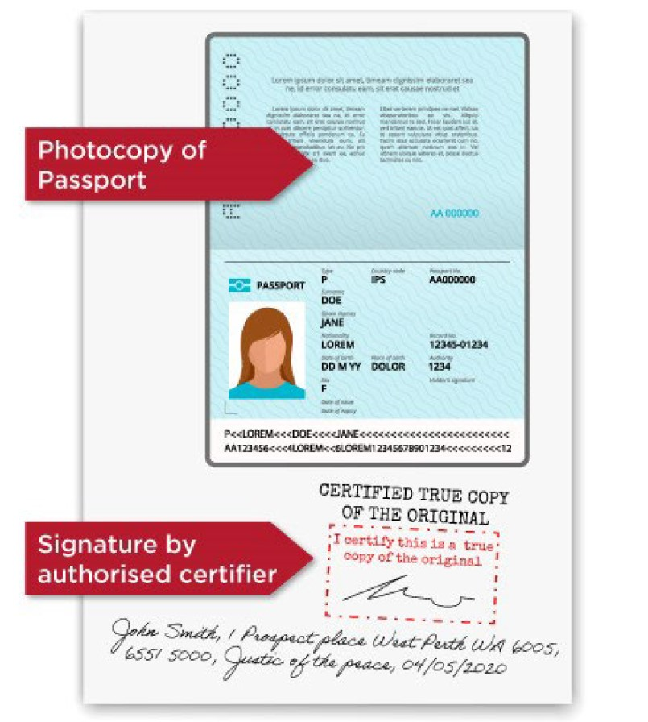
NMBI Candidate Registration
NMBI have a statutory obligation to keep a candidate register of students on nursing and midwifery programmes
Students must register within 60 days of commencing their programme
Students not on the candidate register will be unable to attend ANY practice placements and will be ineligible to apply on completion of the programme for their PIN/license to work
Information on registering is contained in the Orientation Pack
you received
Certified proof of ID is required
PPAO and UCD Legal will offer a once only appointment to have your ID certified on the following dates:
26th September, 03rd and 10th October
all students will receive email on Monday 22nd September offering them opportunity to book appointment

Slide 20
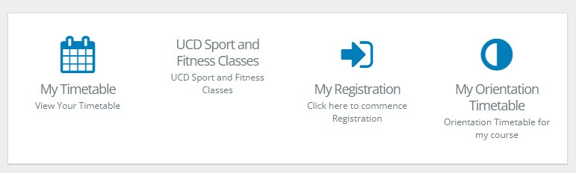
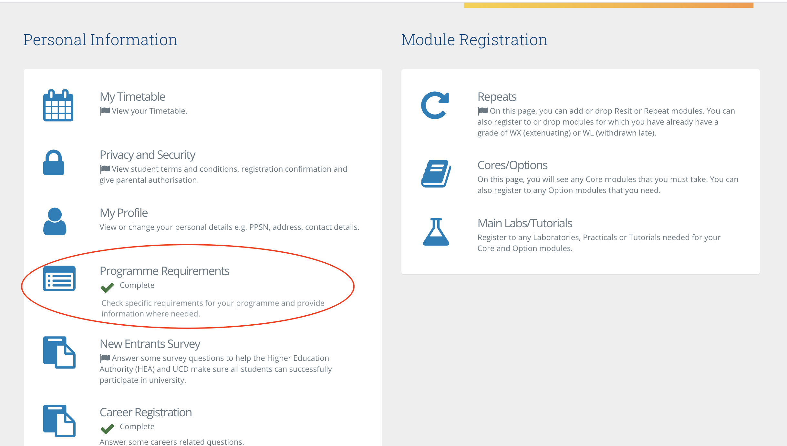

Programme Requirements (SISweb)
Required in order to be considered fully registered on the programme
Log into your
SISweb account
Choose “Programme
Requirements”
This means
it’s complete
Green tick means you have completed it

Slide 21
Basic Life Saving Certification (BLS) & Patient Moving & Handling Certification (M&H)
BLS and M&H are two mandatory certifications that all students must complete in Autumn Trimester.
Failure to complete these certifications in the correct order will result in
students being unable to attend practice placement in Spring Trimester
until they have organised external certification at their own expense and provided said certificates for review
These certifications are offered through the Clinical Skills Labs and will appear under the module NMHS10480 on your timetable.

Slide 22
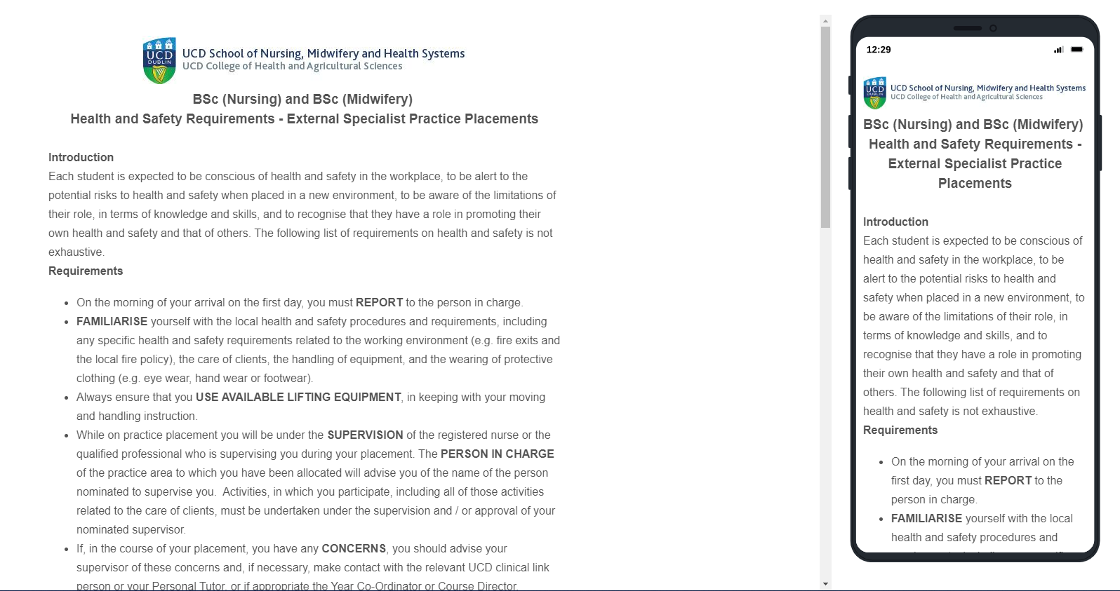
Health and Safety Requirements - External Specialist Practice Placements

Slide 23
Mandatory Requirements
Children's First Certification
  Will complete as part of core module
Parent Hospital(s) required documentation
Parent Hospital Orientation
  Dates as per your orientation pack
Prerequisites to Practice Placement
  You will receive information on this in November
Parent Hospital | Documentation
ALL | Vaccine History Information
CHI | HR Declaration & Confidentiality Agreement
SJOGH | Data Protection Act Agreement Confidentiality & Self Declaration Form

Slide 24
Questions?
Contact us

